Slide 1
Training-Project
Nutrition App(Payment Module)
Prepared by:
Shivani Pareta

Slide 2
About:
Payment Module is one of the module of Nutrition Application. This module is used to make payments on the basis of User Id and Nutrition Plan Id. Also we can provide discounts to various users on the basis of User Id.

Slide 3

Road Map
Technologies involved
Application will be developed in below sprints
Core Java + JDBC + MySQL + Junit + Maven App
Servlet & JSP + HTML +CSS +JS
Spring Boot + React +Redux + Bootstrap4 + Integration of Previous Sprint

Slide 4
Requirements:
User will make payment through insert payment on the basis of Nutrition plan.
User will update payment through update payment for his user Id if he/she changed his/her Nutrition plan.
User will show all payment records through show all records .
And can delete to make deletion of payment.

Slide 5
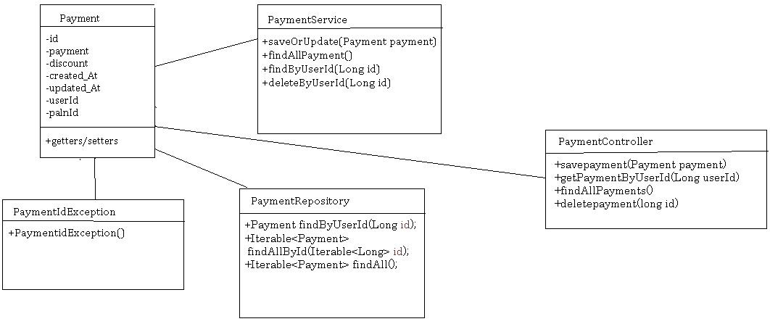
Class Design - Pojos

Slide 6
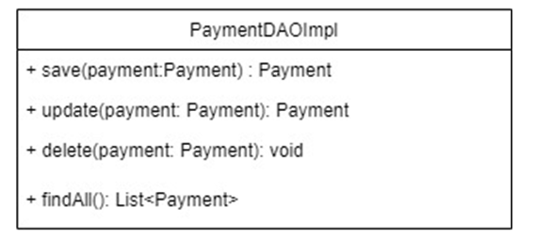
Class Design - Repository

Slide 7
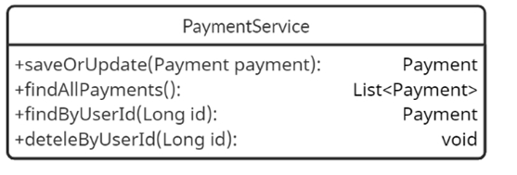
Class Design - Service

Slide 8
Thank you!

